Slide 1
Individual differences in stress
Personality types A, B and C and associated behaviours. hardiness, including commitment, challenge and control

Slide 2
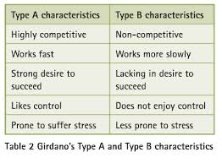
3. Personality types A, B and C and associated behaviours.

Slide 3
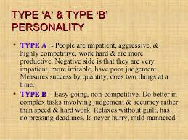

Slide 4
TAB
Friedman and Rosenman - studied people with CHD (coronary heart disease). Decided that people were more susceptible if they had a Type A personality.
Rosenman et al studied over 3000 men allocated them type A or Type B. Followed up and found out of the 257 who had heart attacks 69% were Type A

Slide 5
However
Shekelle et al
12000 males
Found no difference between type A and Type B so not replicated?

Slide 6
Hostility
Dembroski et al found that this was closely linked to CHD.
Miller et al supported this through meta review.

Slide 7
Type C personality traits
Type C personalities are not assertive by nature, This means that they often suppress their desires and wishes instead of standing up for them. That's why Type C personalities are subject to stress and depression more than other personality types. They can spend a considerable amount of time trying to understand how things work.

Slide 8
Type C personality traits
Type C people take life seriously and are usually hard workers to the extent that they become perfectionists Type C personalities are introverts in most cases, As a result of the lack of assertiveness and the desire to work alone they might prefer being on their own rather than being with other people.

Slide 9
Type C personality traits
Morris et Al found Type C women supress their emotion and are more likely to develop cancer.

Slide 10
Type D
D= distressed – high levels of negative emotions and social inhibition.
Denollet Type D: vulnerable to Heart Disease – 53% of cardiac patients exhibited Type D personality. I a later study found that type D were 4 times more likely to suffer sudden cardiac death.

Slide 11
Hardiness
Kobasa suggested three elements that buffer against stress.
Control: Sense of personal control over what they are doing.
Commitment (the individuals sense of involvement and purpose in life.)
Challenge: opportunity rather stress.

Slide 12
Hardiness detail
Commitment is the tendency to involve oneself in, rather than experience alienation from, whatever one is doing or encounters in life. Committed persons have a generalized sense of purpose that allows them to identify with and find meaningful the persons, events and things of their environment.
Control is the tendency to think, feel and act as if one is influential, rather than helpless, in the face of the varied contingencies of life. Persons with control do not naively expect to determine all events and outcomes but rather perceive themselves as being able to make a difference in the world through their exercise of imagination, knowledge, skill and choice.
Challenge is the tendency to believe that change rather than stability is normal in life and that changes are interesting incentives to growth rather than threats to security. So far from being reckless adventurers, persons with challenge are rather individuals with an openness to new experiences and a tolerance of ambiguity that enables them to be flexible in the face of change.”

Slide 13
Hardiness Experiment
Kobasa 800 Business executives. People with similar stress level had different illness levels. This indicates hardiness and further investigation showed that those with low illness scored high on Control commitment and challenge.
Sarafino – found those that had hardiness training suffered from lower blood pressure.

Slide 14
Hardiness
Hardy personality types have lower stress levels so suffer from stress related illness less.
Questionnaires used to collect data.
Repeated with similar results Beasley et al.
Type A may have hardiness built in?

Slide 15
Problems
Self report
Other factors eg: drinking and smoking
Social influences: Ie, poor = poor diet = heart disease
Correlation research association not causality.
Over simplification of personality types.

Slide 16
Exam
Roy and Mick are members of a football team; both play to the same high standard.
Roy never minds if the team does not win; he just enjoys playing with his team-mates
and spending time with them after the match. Mick always wants to win and gets angry if the team loses.
3 (a) Which personality type is each person likely to have?
Roy ....................................................................................................................................
Mick ...................................................................................................................................
(2 marks)
3 (b) Explain whether Roy or Mick is more likely to suffer from a stress-related illness.
Use research in your explanation. (4)

Slide 17
Answer
3 (a) Roy = Type B / B / Personality Type B
And Mick = Type A / A / Personality Type A
(1 mark for each correct answer)
3 (b) It is people with Type A behaviour who are more likely to suffer the negative effects of stress. So in the scenario it is Mick (competitive and angry when loses) who is more likely to suffer from CHD. Friedman and Rosenman research indicated that it is those with Type A who become ill as a consequence of their stress. Type B people such as Roy who doesn’t get physically aroused at losing, are much less likely to experience the “fight or flight” response and so less likely to have raised blood pressure etc.
Examiners need to remember that “research‟ can include both theories and studies.
For full marks there must be explicit engagement with the stem.

Slide 18
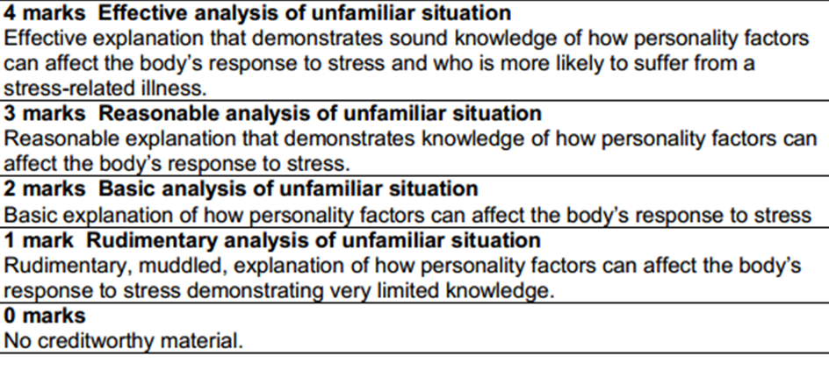

Slide 19
• The physiology of stress, including general adaptation syndrome, the hypothalamic pituitary-adrenal system, the sympathomedullary pathway and the role of cortisol.
• The role of stress in illness, including reference to immunosuppression and cardiovascular disorders.
• Sources of stress: life changes and daily hassles. Workplace stress, including the effects of workload and control.
• Measuring stress: self-report scales (Social Readjustment Ratings Scale and Hassles and Uplifts Scale) and physiological measures, including skin conductance response.
• Individual differences in stress: personality types A, B and C and associated behaviours; hardiness, including commitment, challenge and control.
• Managing and coping with stress: drug therapy (benzodiazepines, beta blockers), stress inoculation therapy and biofeedback. Gender differences in coping with stress. The role of social support in coping with stress; types of social support, including instrumental, emotional and esteem support.

Slide 20
Physiological measures, including skin conductance response.
How have they measured stress so far? SRRS.
What are the problems with this?
What happens when Adrenaline is released into the system?
A pocket Guide:

Slide 21
The release of these hormones cause a variety of physiological responses in the body including:
Increased heart rate
Increased blood pressure
Increase in sweating
Scientists in the 19th century realised that skin is electrically active and that this electrical activity is conducted when the skin is wet (skin conductance response).

Slide 22
GSR
As sweat is produced, the amount of electricity that is conducted increases.
This effect is strongest in the palms of the hands and soles of the feet (because there is a high density of eccrine sweat glands at these points – glands which are responsive to emotional stimuli).
To measure the skin conductance response, two electrodes are placed on a person’s index and middle finger.
A very small voltage (0.5v) is applied across these electrodes. By measuring the current that flows, conductance can be reported (in microSiemens).

Slide 23
Other Physiological Measures:
A simple way to assess stress is to measure blood pressure.
Kamarck et al (1990) looked at the effect of social support on stress by measuring blood pressure and heart rate before doing a set of mental tasks and again afterwards.
Those participants who had a close same sex friend holding their wrist throughout the task were less stressed.
Cortisol is the hormone produced as a response to ongoing stressors and can be measured in saliva or urine.
Gunnar et al (2010) assessed stress in children (3-4½ years) by measuring salivary cortisol. Children in day care showed higher stress levels, and these were highest in situations of intrusive, over-controlling care.

Slide 24
Evaluation, AO3 – Measuring Stress: Physiological Measures
Strengths:
  Point: Using physiological measures avoids some of the problems associated with self-report measures.
  Evidence: For example, using physiological methods avoids things like social desirability because participants are not asked to independently judge their stress levels. The measures that are used are independent of the participant and objective.
  Evaluation: This is a strength because removing participant judgement is more likely to produce accurate results, allowing the experimenter to measure what they are intending to measure – this will increase internal validity.
Weaknesses:
  Point: However, an issue with using physiological measures is that what is actually being measured is sympathetic arousal, which occurs in response to any emotion, it may not just be stress that causes the activity of the SNS.
  Evidence: For example, it could be that the participant is experiencing fear, anger, surprise or sexual arousal which would all lead to increased sweat and increased skin conductance.
  Evaluation: This is a weakness because it may be the cause that the test isn’t actual measuring what it intends to measure (i.e. the stress response) which could cause inaccurate results.

Slide 25
Back to the strengths:
  Point: However, a strength of skin conductance response is that it has led to other applications/uses.
  Evidence: For example, skin conductance response has been used as a way of determining whether someone is lying – the polygraph or lie detector test.
  Evaluation: This is a strength because to have such a test is very appealing because it would make it so easy to detect dishonesty.
However: as previously discussed, the skin conductance test is not a very dependable measure of deceitfulness. Furthermore, Oshumi and Ohira found that psychopaths generally lack emotional responsiveness which means they can lie without any associated physiological response.

